Slide 1
DATA SPARK ILLUMINATING INSIGHTS FOR GLOBAL ELECTRONICS
A Data-Driven Approach to Electronics Market Intelligence
by BUVANESH.R

Slide 2
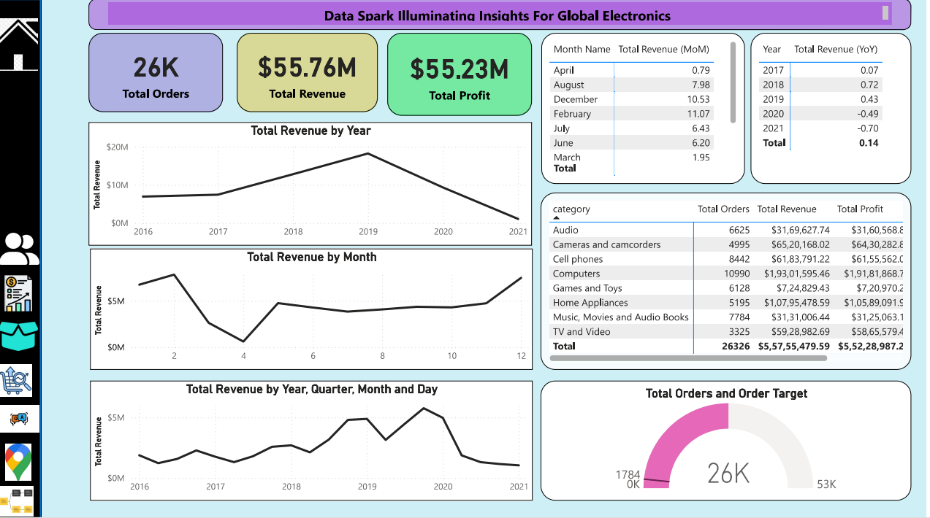
Introduction
● Overview of Data Spark’s role in electronics insights.
● Focus: Enhancing decision-making through analytics.
● Global scope: Manufacturers, suppliers, and consumers

Slide 3
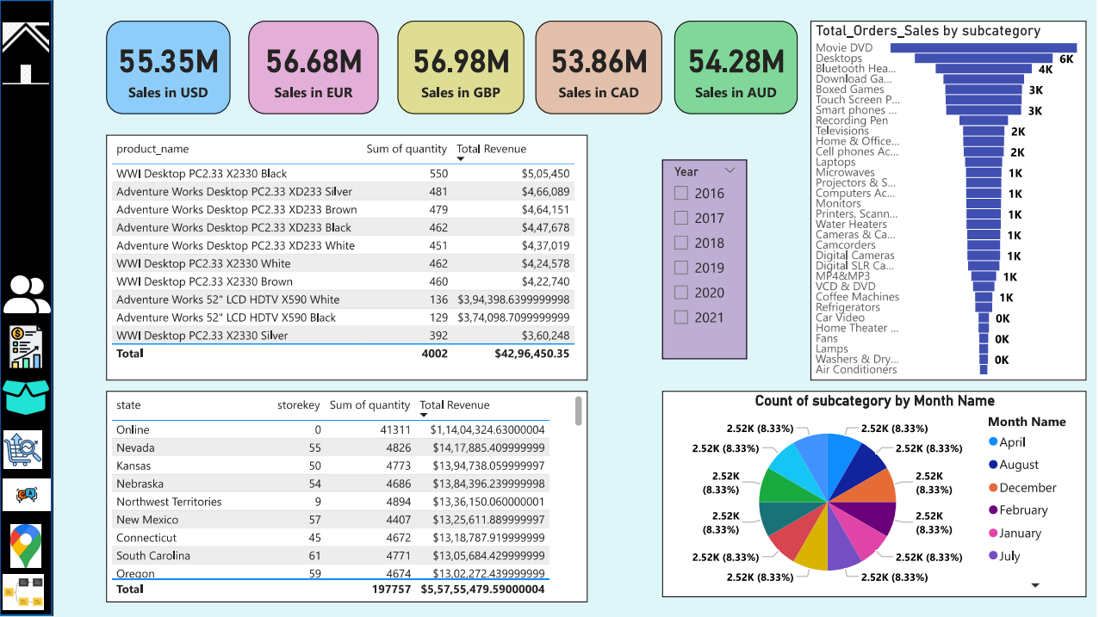
Market Trends & Challenges
● Increasing demand for semiconductors and IoT devices.
● Supply chain disruptions post-COVID.
● Rapid technological evolution.
● Sustainability and regulatory pressures

Slide 4
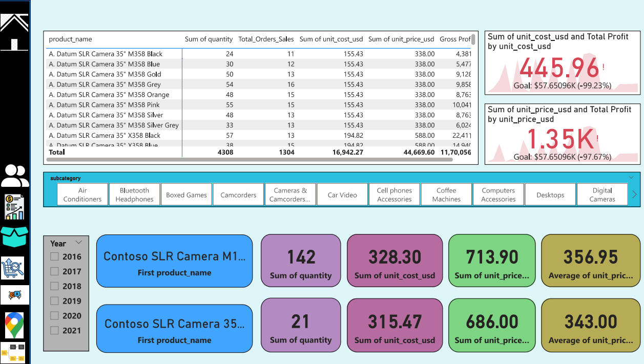
Data Spark’s Analytics Approach
● Uses big data and AI for real-time analysis.
● Proprietary datasets and algorithms.
● Geospatial and behavioral data integration

Slide 5
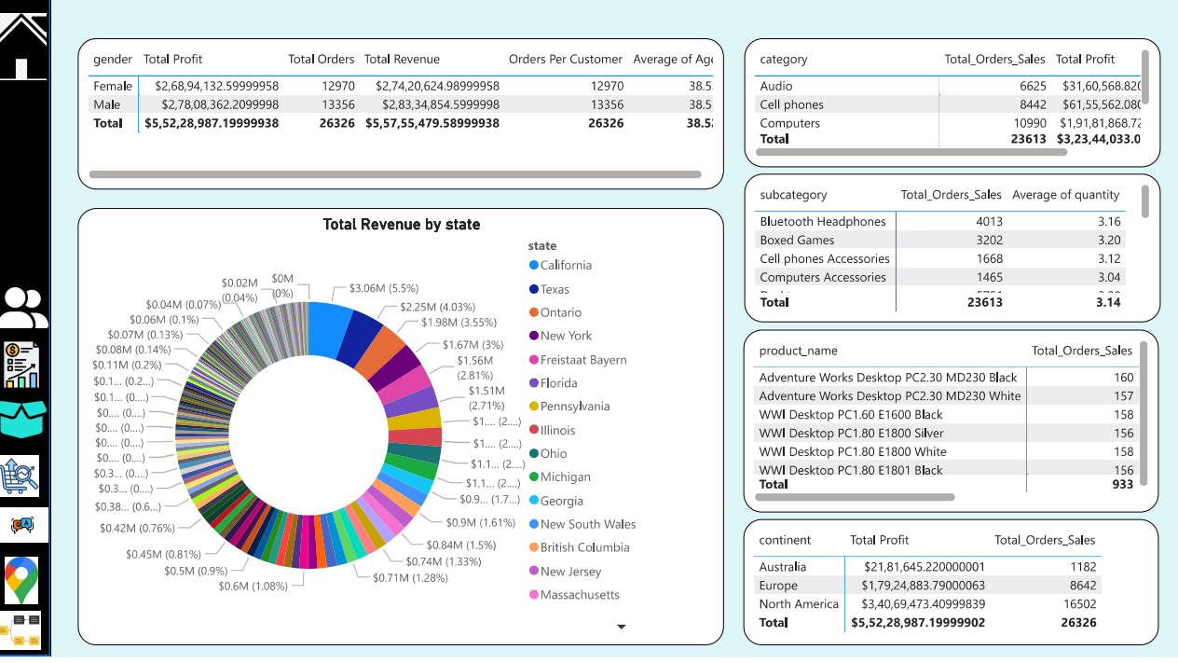
Key Insights Delivered
● Consumer behaviour shifts
● Competitive benchmarking
● Product lifecycle tracking
● Predictive demand analytics

Slide 6
Case Study – Semiconductor Supply Chain
● Early warning system for shortages
● Real-time inventory and supplier monitoring
● Demand forecasting for key regions

Slide 7
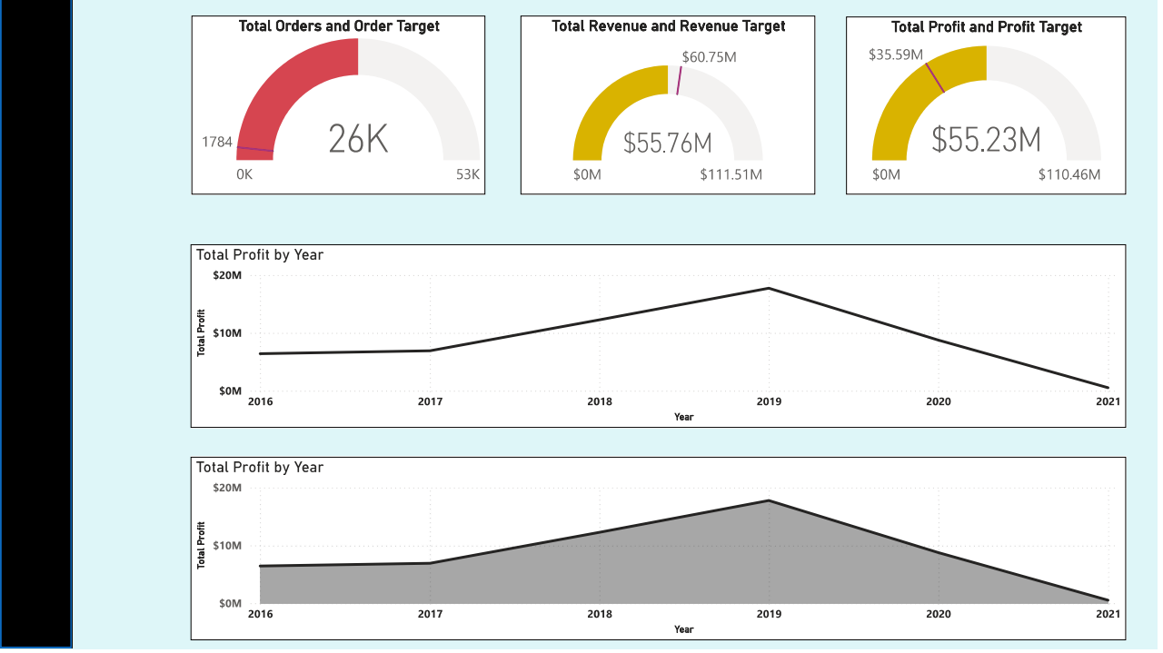
Business Impact
● Improved decision-making timelines
● Reduction in supply chain risks
● Enhanced R&D targeting and efficiency

Slide 8
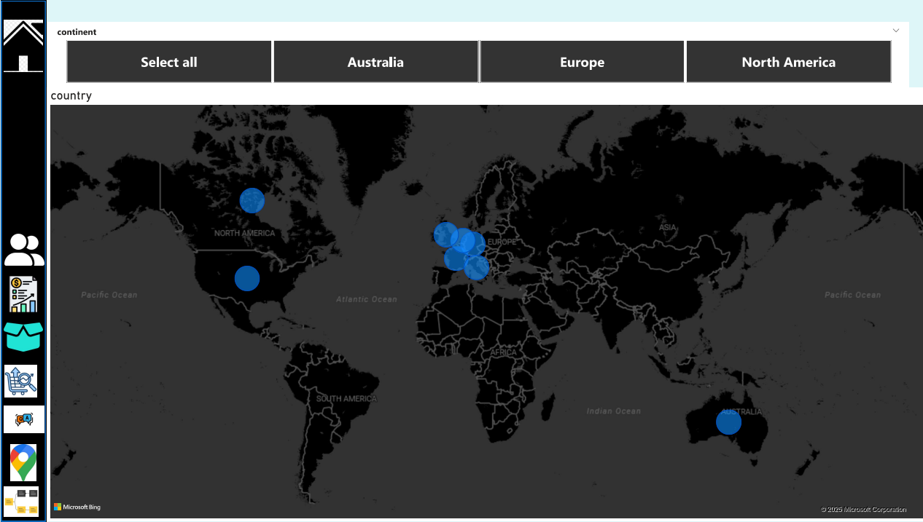
Global Reach
● Coverage of major electronics markets: US, EU, Asia-Pacific
● Real-time updates and regional breakdowns
● Localization of insights

Slide 9
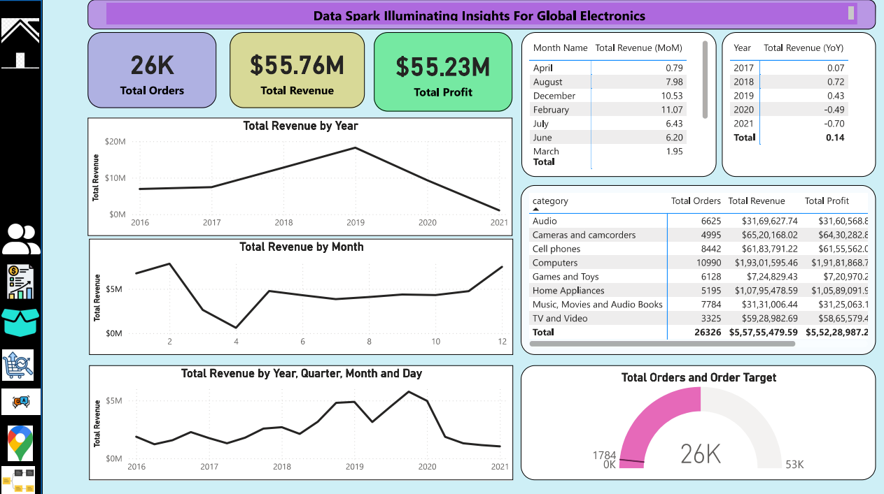
Future Outlook
● Expansion into new verticals (e.g., automotive electronics)
● AI model enhancements for faster forecasting
● Focus on sustainability metrics

Slide 10
Conclusion
● Data Spark empowers businesses through actionable insights
● Strategic advantage in a volatile electronics landscape
● Ongoing innovation and client support

